Slide 1




Introduction to
Robotic Process Automation
Pixel Pilot -
Design Automation Bot
2116220701265
Sharukeshwar P
Ms. U. Farzana, M. Tech
B. E. Computer Science & Engineering

Slide 2
Abstract
Pixel Pilot is an RPA-based project that automates repetitive design tasks, leveraging UiPath's advanced automation capabilities.
It integrates Computer Vision and UI activities to interact with tools like Canva, enabling dynamic element identification and seamless design modifications.
The project aims to streamline workflows, enhance productivity, and free creators to focus on innovation.
Department of Computer Science and Engineering
Rajalakshmi Engineering College 1
Notes:
‹#›

Slide 3
Need for the Proposed System
Repetitive Design Tasks
Uniformity in Branding
Prone to Manual Errors
Cost-Effective Solutions
Real-Time Customization
Time-Consuming Learning Curves
Creative Freedom
Department of Computer Science and Engineering
Rajalakshmi Engineering College 2
Notes:
‹#›

Slide 4
Advantages of the Proposed System
Automation of Repetitive Tasks
Enhanced Efficiency
Consistency in Branding
Error Reduction
User-Friendly Interface
Creative Focus
Scalability
Department of Computer Science and Engineering
Rajalakshmi Engineering College 3
Notes:
‹#›

Slide 5
Literature Survey
Paper 1 (refer to “IEEE Paper” Section)
Key Takeaways :
Leveraging RPA for Data Extraction (like web scraping, etc.)
User-Centric Automation
Integration with AI Models
Disadvantages :
Limited Dataset Diversity
Potential for Reduced Human Oversight
Bias and Generalization Issues
Department of Computer Science and Engineering
Rajalakshmi Engineering College 4
Notes:
‹#›

Slide 6
Main Objective
creative
focus.
"BUT WHY IS IT IMPORTANT?"
Department of Computer Science and Engineering
Rajalakshmi Engineering College 5
Notes:
‹#›

Slide 7
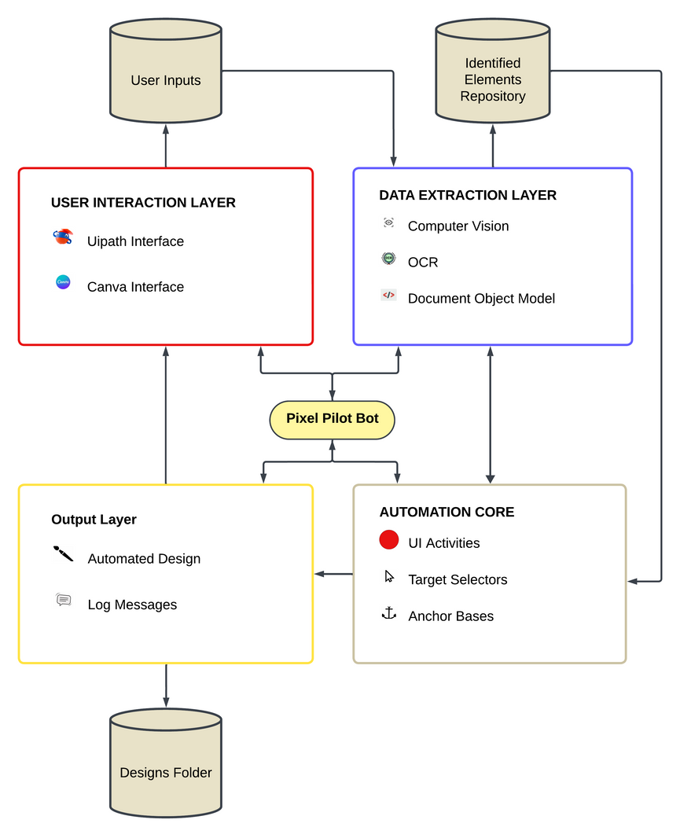
Architecture
Department of Computer Science and Engineering
Rajalakshmi Engineering College 6
Notes:
‹#›

Slide 8
System Requirements
Hardware
Standard Computer
Stable Network
Software
UiPath Studio
UiPath Computer Vision
Access to Canva account
Department of Computer Science and Engineering
Rajalakshmi Engineering College 7
Notes:
‹#›

Slide 9
Functional Description
Input and Decision Module
Facilitates tasks like accepting user design preferences(font name, color, etc.) and identifying elements for automation.
UI Automation Module
Interacts with the design tool's interface to perform automated actions like clicking buttons, entering text, dragging elements, and extracting data.
Sub process 1
String Input
IF-THEN Block
Sub process2
CV Detection
Target Selection
Desired UI Activity
Department of Computer Science and Engineering
Rajalakshmi Engineering College 8
Notes:
‹#›

Slide 10
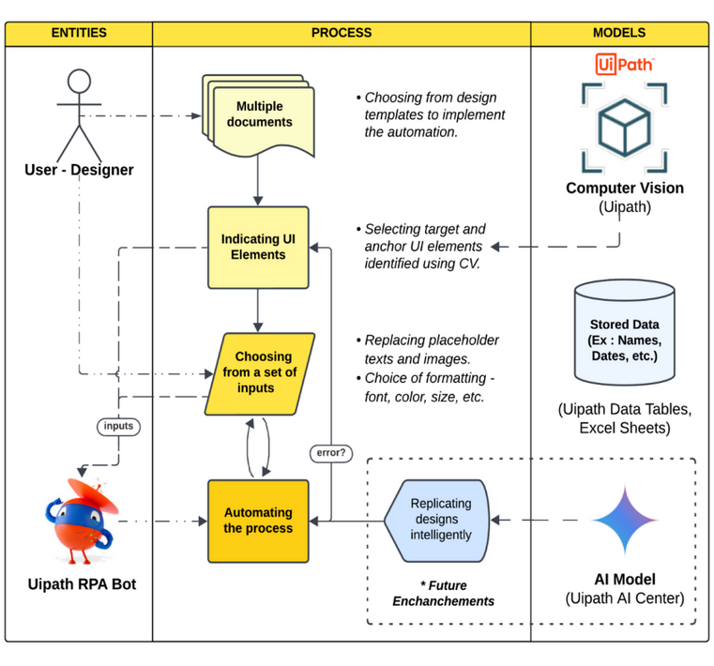
Process Design
Department of Computer Science and Engineering
Rajalakshmi Engineering College 9
Notes:
‹#›

Slide 11
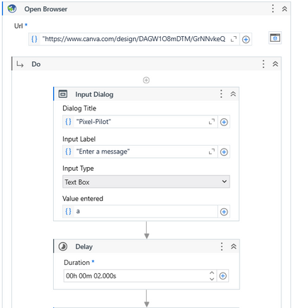
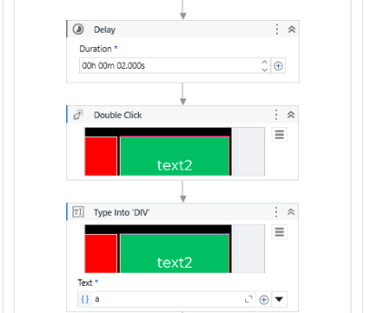
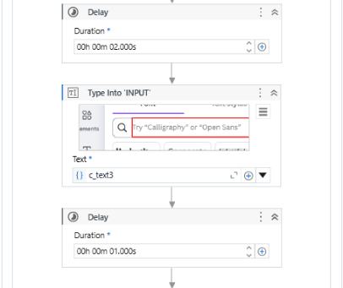
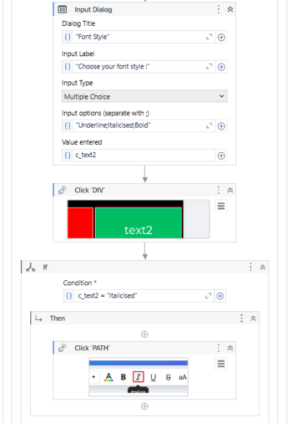
Implementation
Input & Decision Module :
UI Automation Module :
Department of Computer Science and Engineering
Rajalakshmi Engineering College 10
Notes:
‹#›

Slide 12
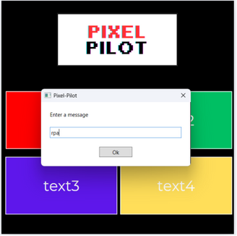
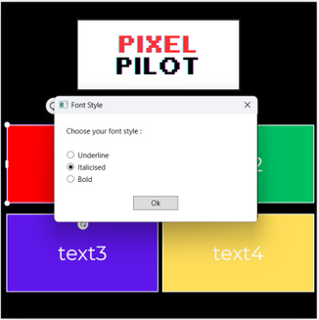
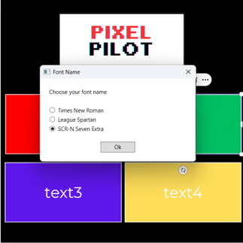
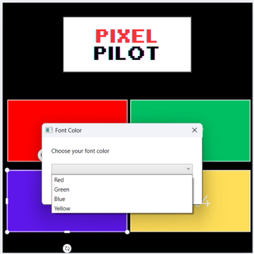
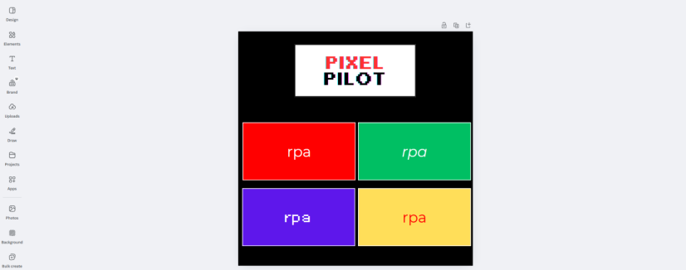
Testing
final design =>
Department of Computer Science and Engineering
Rajalakshmi Engineering College 11
Notes:
‹#›

Slide 13
Conclusions
The development of Pixel Pilot marks a significant step toward automating repetitive design tasks in platforms like Canva.
The implementation showcases the potential of RPA tools in bridging the gap between manual design processes and full automation, proving Pixel Pilot as an effective productivity enhancer.
Department of Computer Science and Engineering
Rajalakshmi Engineering College 12
Notes:
‹#›

Slide 14
Future Enhancement
AI-Driven Creative Customization :
Objective : Integrate advanced AI models that analyze user behavior and preferences to create designs tailored to individual creative styles.
Real-Time Cross-Platform Integration :
Objective: Expand Pixel Pilot's capabilities to operate seamlessly across multiple design tools (e.g., Canva, Figma, Adobe Creative Cloud) and social media platforms.
Department of Computer Science and Engineering
Rajalakshmi Engineering College 13
Notes:
‹#›

Slide 15
IEEE Paper
Title : System Design and Development for Robotic Process Automation
Authors :
Yi-Wei Ma & Jiann-Liang Chen, Department of Electrical Engineering, National Taiwan University of Science and Technology, Taipei, Taiwan
Dan-Ping Lin, Logistics Engineering College, Shanghai Maritime University, Shanghai, China
Shiang-Jiun Chen & Hsiu-Yuan Chu, Digital Transformation Institute, Institute of Information Industry, Taipei, Taiwan
Department of Computer Science and Engineering
Rajalakshmi Engineering College 14
Notes:
‹#›

Slide 16
References
1. UiPath Documentation : [https://docs.uipath.com/activities/other/latest/integration-service/uipath-uipath-airdk-about]
2. Canva Help Center : [https://www.canva.com/help/]
3. Computer Vision Techniques in UiPath :
Blog: "Leveraging UiPath’s Computer Vision for Robust
Automation."
[https://www.uipath.com/blog]
4. Automation Anywhere vs UiPath: A Comparative Study :
White Paper : How UiPath excels in UI-based automation
scenarios.
[https://www.automation.com/]
5. IEEE Paper : System Design and Development for RPA
[https://ieeexplore.ieee.org/document/9091399]
6. Online Tutorials and Resources:
UiPath Official Documentation
YouTube Tutorials
UiPath Online Forums
Github
Department of Computer Science and Engineering
Rajalakshmi Engineering College 15
Notes:
‹#›

Slide 17
Queries
Notes:
‹#›

Slide 18
Demonstration
Notes:
‹#›

Slide 19
Thank You
Notes:
‹#›

